Slide 1
5G Capstone Project
By
Thammineni Satish

Slide 2
What is 5G
The 5th generation of mobile network or more commonly known as 5G is the new global standard. Just like its predecessors 1G, 2G, 3G, and 4G;
5G offers a completely different spectrum of the network ensuring that it can connect to everyone and bring forth all the devices, and machines together.
The 5G technology is primarily meant for delivering multi-Gbps data speed along with ultra-low latency, reliability, and massive network capabilities are some of its hidden perks.
5G can offer new services that can completely revolutionize the industry with its super reliable, always available, and stable network. This can benefit the remote operations of critical infrastructure, vehicles as well as any medical procedures.
Most Common Use Cases of 5G
Enhanced Mobile Broadband
Mission-Critical Communities
Not only in smartphones, but 5G enables new opportunities for both Virtual Reality and Augmented Reality. With its faster, uniform data rates, users can expect a lower latency along with reduced cost-per-bit.
5G has the capabilities to seamlessly connect with a large number of embedded sensors. This again can be beneficial over scaling down the cost of data rates along with better mobility and power. With such lower connectivity costs, enterprises can mass-produce IoT devices
Massive IoT

Slide 3
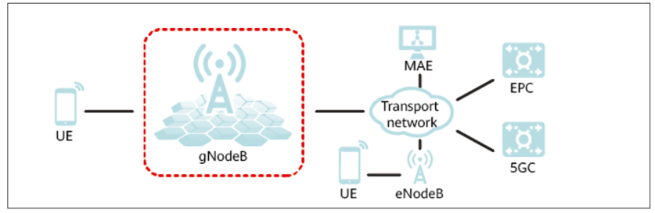
What is a gNodeB
5G base station protocol function entity. In 3G CDMA networks, a base station is called a NodeB. In 4G LTE networks, a base station is called an E-UTRAN NodeB. In 5G NR networks, a base station is called a gNodeB.
As a 5G network element, the gNodeB provides radio links between UEs and the network.
A gNodeB has a number of functions, which include:
Radio resource management
Mobility management
Connection management
Security
Quality of service (QoS)
Charging

Slide 4
5G GNODEB BASE STATION
5G Non-Standalone (NSA) vs Standalone (SA)
gNodeB Base Stations are used for 5G-SA and 5G-NSA networks. Initial 5G NR launches depend on existing LTE (4G) infrastructure in non-standalone (NSA) mode (5G NR software on LTE radio hardware), before maturation of the standalone (SA) mode (5G NR software on 5G NR radio hardware) with the 5G core network.
A 5G Base Station uses New Radio (NR) technology and is referred to as a gNodeB (gNb). gNodeB radios features Software Defined Radio (SDR) with various MIMO options including 2×2, 4×4, 8×8 and Massive MIMO options for higher capacities. Options for 5G deployment in Sub-6GHz bands as well as Millimeter Wave (mmWave) bands are available.
5G Spectrum: Frequency Bands
Frequency bands for 5G NR are being separated into two different frequency ranges.
Frequency Range 1 (FR1) includes sub-6GHz frequency bands, some of which are bands traditionally used by previous standards, but has been extended to cover potential new spectrum offerings from 410 MHz to 7125 MHz.
Frequency Range 2 (FR2) includes frequency bands from 24.25 GHz to 52.6 GHz. Bands in this millimeter wave range have shorter range but higher available bandwidth than bands in the FR1

Slide 5
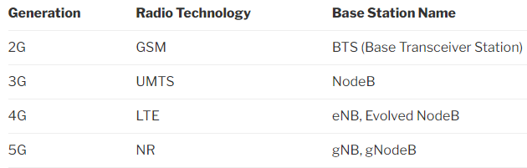
gNodeB and the Evolution of Cellular Technology
The new radio access technology for 5G is called “NR” and replaces “LTE”, and the new base station is called gNB (or gNodeB), and replaces the eNB (or eNodeB or Evolved Node B).

Slide 6
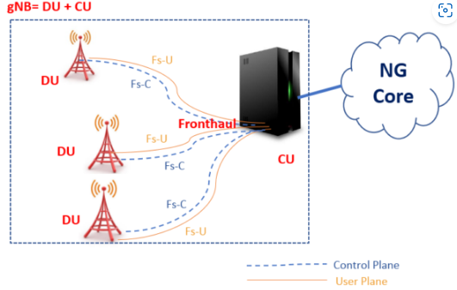
5G NR gNB Logical Architecture and It’s Functional Split Options
The logical architecture of gNB is shown in figure with Central Unit (CU) and Distributed Unit (DU). Fs-C and Fs-U provide control plane and user plane connectivity over Fs interface.
In this architecture, Central Unit (CU) and Distribution Unit (DU) can be defined as follows.
Central Unit (CU): It is a logical node that includes the gNB functions like Transfer of user data, Mobility control, Radio access network sharing, Positioning, Session Management etc., except those functions allocated exclusively to the DU. CU controls the operation of DUs over front-haul (Fs) interface. A central unit (CU) may also be known as BBU/REC/RCC/C-RAN/V-RAN
Distributed Unit (DU): This logical node includes a subset of the gNB functions, depending on the functional split option. Its operation is controlled by the CU. Distributed Unit (DU) also known with other names like RRH/RRU/RE/RU.

Slide 7
CU-DU Architecture
AMF
UPF
AMF
UPF
NG-C
NG-U
NG-C
NG-U
gNB
CU-CP
gNB
CU-UP
RRC
SDAP
RRC
SDAP
PDCP
PDCP
Xn-U
PDCP
F1-C
F1-U
DU
RLC
RLC
MAC
MAC
PHYSICAL
PHYSICAL

Slide 8
RRC (Radio Resource Control)
RRC Layer is a control plane protocol stack.
RRC is a L3 layer protocol.
The RRC Services and Functions
The main services and functions of the RRC sublayer include:
Broadcast of System Information related to AS and NAS
Paging initiated by 5GC or NG-RAN
Establishment, maintenance, and release of an RRC connection between the UE and NG-RAN including
Addition, modification, and release of carrier aggregation
Addition, modification, and release of Dual Connectivity in NR or between E-UTRA and NR.
Security functions including key management
Establishment, configuration, maintenance, and release of Signalling Radio Bearers (SRBs) and Data Radio Bearers (DRBs);
Mobility functions including:
Handover and context transfer
UE cell selection and reselection and control of cell selection and reselection
Inter-RAT mobility
QoS management functions
UE measurement reporting and control of the reporting
Detection of and recovery from radio link failure
NAS message transfer to/from NAS from/to UE.

Slide 9
PDCP Layer & functions
PDCP: (Packet Data Convergence Protocol)
Functions:
Transfer of data (user plane or control plane)
Maintenance of PDCP SNs
Header compression and decompression using the ROHC
Ciphering and deciphering
Integrity protection and integrity verification
Timer based SDU discard
For split bearers,routing
Duplication
Reordering and in-order delivery
Out-of-order delivery
Duplicate discarding

Slide 10
RLC (RADIO LINK CONTROL):
RRC is generally in control of the RLC configuration.
For an RLC entity configured at the gNB, there is a peer RLC entity configured at the UE and vice versa.
An RLC entity receives/delivers RLC SDUs from/to upper layer and sends/receives RLC PDUs to/from its peer RLC entity via lower layers.
An RLC PDU can either be an RLC data PDU or an RLC control PDU. If an RLC entity receives RLC SDUs from upper layer, it receives them through a single RLC channel between RLC and upper layer, and after forming RLC data PDUs from the received RLC SDUs, the RLC entity submits the RLC data PDUs to lower layer through a single logical channel.
If an RLC entity receives RLC data PDUs from lower layer, it receives them through a single logical channel, and after forming RLC SDUs from the received RLC data PDUs, the RLC entity delivers the RLC SDUs to upper layer through a single RLC channel between RLC and upper layer. If an RLC entity submits/receives RLC control PDUs to/from lower layer, it submits/receives them through the same logical channel it submits/receives the RLC data PDUs through.
An RLC entity can be configured to perform data transfer in one of the following modes.
Transparent Mode (TM)
Unacknowledged Mode (UM)
Acknowledged Mode (AM)

Slide 11
SDAP(SERVICE DATA ADAPTATION PROTOCOL)
The User-plane protocol structure of NR is developed similar concepts like LTE, but obviously with some differences. The major difference in User-plane protocol structure in LTE and NR is the introduction of a new layer in the stack called SDAP.
Some IMP points:
The PDU session and QoS flow is identified by gNB by a GTP- U header.
After this the SDAP layer maps it into specific DRB.
If header is used for reflective QoS, SDAP layer specifies the QoS flow associated with the packet. By using this information, the UE can decode the mapping between the QoS flow and DRB for uplink transmission.
In Downlink the QoS Flow under the PDU session is identified using identity in GTP- U Header called GTP-U tunnel End Point Identifier (TEID)

Slide 12
Central Unit (CU) provides support for the higher layers of the protocol stack such as SDAP, PDCP and RRC.
Distributed Unit (DU) provides support for the lower layers of the protocol stack such as RLC, MAC and Physical layer. Also, note that SDAP layer will not be present if the CU is connected to a 4G Core network as we should have 5G core network to support SDAP.
Here is a single CU for each gNB, but one CU controls multiple DUs, for example more than 100 DUs can be connected to one CU.
Each DU is able to support one or more cells, so one gNB can control hundreds of cells unlike the 4G BTS. Also, note that the interface between CU and DU is named F1 and as per 3GPP, it should be an open interface, so you connect one CU from vendor X to another DU from vendor Y.

Slide 13
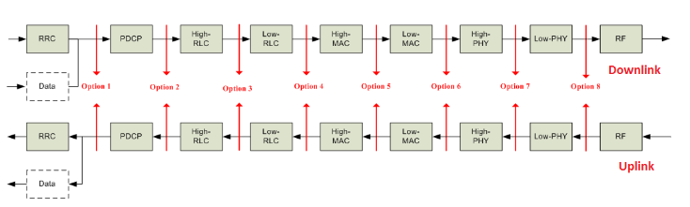
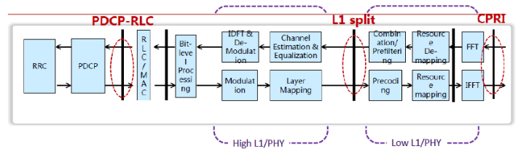
Central Unit (CU) and Distributed Unit (DU) Functional Split Options
As a part of study item for New Radio (NR), 3GPP started studying different functional splits between central and distributed units. For the initial phase, 3GPP has taken LTE protocol stack as a basis for the discussion, until RAN2 defines and freezes the protocol stack for New Radio (NR). They have proposed about 8 possible options shown in below figure.
Option 1 (RRC/PCDP 1A-like split)
Option 2 (PDCP/RLC Split 3C-like split)
Option 3 (High RLC/Low RLC split, Intra RLC split)
Option 4 (RLC-MAC split)
Option 5 (Intra MAC split)
Option 6 (MAC-PHY split)
Option 7 (Intra PHY split)
Option 8 (PHY-RF split)

Slide 14
Option 1 (RRC/PDCP, 1A-like split): In this split option, RRC is in the central unit while PDCP, RLC, MAC, physical layer and RF are kept in the distributed unit. Thus the entire user plane is in the distributed unit.
Option 2 (PDCP/RLC split): Option 2 may be a base for an X2-like design due to similarity on U-plane but some functionality may be different e.g. C-plane since some new procedures may be needed. There are two possible variants available in this option.
Option 2-1 Split U-plane only (3C like split): In this split option, RRC, PDCP are in the central unit. RLC, MAC, physical layer and RF are in the distributed unit.
Option 2-2: In this split option, RRC, PDCP are in the central unit. RLC, MAC, physical layer and RF are in the distributed unit. In addition, this option can be achieved by separating the RRC and PDCP for the CP stack and the PDCP for the UP stack into different central entities.
Option 3 (High RLC/Low RLC Split): In this option, two approaches are taken based on Real time/Non-Real time functions split which are as follows:
Option 3-1 Split based on ARQ
Option 3-2 Split based on TX RLC and RX RLC
Option 3-1 Split based on ARQ
Low RLC may be composed of segmentation functions;
High RLC may be composed of ARQ and other RLC functions;
This option splits the RLC sublayer into High RLC and Low RLC sublayers such that for RLC Acknowledge Mode operation, all RLC functions may be performed at the High RLC sublayer residing in the central unit, while the segmentation may be performed at the Low RLC sublayer residing in the distributed unit. Here, High RLC segments RLC PDU based on the status reports while Low RLC segments RLC PDU into the available MAC PDU resources.

Slide 15
Option 3-2 Split based on TX RLC and RX RLC
Low RLC may be composed of transmitting TM RLC entity, transmitting UM RLC entity, a transmitting side of AM and the routing function of a receiving side of AM, which are related to downlink transmission.
High RLC may be composed of receiving TM RLC entity, receiving UM RLC entity and a receiving side of AM except for the routing function and reception of RLC status reports, which are related to uplink transmission.
Option 4 (RLC-MAC split): In this split option, RRC, PDCP, and RLC are in the central unit. MAC, physical layer, and RF are in the distributed unit.
Option 5 (Intra MAC split)
Option 5 assumes the following distribution:
RF, physical layer and lower part of the MAC layer (Low-MAC) are in the Distributed Unit
Higher part of the MAC layer (High-MAC), RLC and PDCP are in the Central Unit
Therefore, by splitting the MAC layer into 2 entities (e.g. High-MAC and Low-MAC), the services and functions provided by the MAC layer will be located in the Central Unit (CU), in the Distributed Unit (DU), or in both. An example of this kind distribution given below.
In High-MAC sublayer the centralized scheduling in the High-MAC sublayer will be in charge of the control of multiple Low-MAC sublayers. It takes high-level centralized scheduling decision. The inter-cell interference coordination in the High-MAC sublayer will be in charge of interference coordination methods such as JP/CS CoMP.
In Low-MAC sublayer the time-critical functions in the Low-MAC sublayer include the functions with stringent delay requirements (e.g. HARQ) or the functions where performance is proportional to latency (e.g. radio channel and signal measurements from PHY, random access control). It reduces the delay requirements on the fronthaul interface. Radio specific functions in the Low-MAC sublayer can for perform scheduling-related information processing and be reporting. It can also measure/estimate the activities on the configured operations or the served UE’s statistics and report periodically or as requested to the High-MAC sublayer.

Slide 16
Option 6 (MAC-PHY split): The MAC and upper layers are in the central unit (CU). PHY layer and RF are in the DU. The interface between the CU and DUs carries data, configuration, and scheduling-related information (e.g. MCS, Layer Mapping, Beamforming, Antenna Configuration, resource block allocation, etc.) and measurements.
Option 7 (Intra PHY split): Multiple realizations of this option are possible, including asymmetrical options which allow obtaining benefits of different sub-options for UL and DL independently.
This option requires some kind of compression technique to reduce transport bandwidth requirements between the DU and CU.
In the UL, FFT, and CP removal reside in the DU and for the two sub-variants, 7-1 and 7-2 are described below. Remaining functions reside in the CU.
In the downlink, iFFT and CP addition reside in the DU and the rest of the PHY resides in the CU.
Considering above there are three sub-variant available for this option described as below
Option 7-1 In this option the UL, FFT, CP removal and possibly PRACH filtering functions reside in the DU, the rest of PHY functions reside in the CU. In the DL, iFFT and CP addition functions reside in the DU, the rest of PHY functions reside in the CU.
Option 7-2 In this option the UL, FFT, CP removal, resource de-mapping and possibly pre-filtering functions reside in the DU, the rest of PHY functions reside in the CU. In the DL, iFFT, CP addition, resource mapping and precoding functions reside in the DU, the rest of PHY functions reside in the CU.
Option 7-3 (Only for DL): Only the encoder resides in the CU, and the rest of PHY functions reside in the DU.
Option 8 (PHY-RF split): This option allows to separate the RF and the PHY layer. This split permit centralization of processes at all protocol layer levels, resulting in very tight coordination of the RAN. This allows efficient support of functions such as CoMP, MIMO, load balancing, mobility.

Slide 17
Benefits of RAN Spilt Architecture
Some of the benefits of an architecture with the deployment flexibility to split and move New Radio (NR) functions between central and distributed units are below:
Flexible HW implementations allows scalable cost-effective solutions
A split architecture (between central and distributed units) allows for coordination for performance features, load management, real-time performance optimization, and enables NFV/SDN
Configurable functional splits enables adaptation to various use cases, such as variable latency on transport
Which split function to use where?
The choice of how to split New Radio (NR) functions in the architecture depends on some factors related to radio network deployment scenarios, constraints and intended supported services. Some examples of such factors are:
Support of specific QoS per offered services (e.g. low latency, high throughput)
Support of specific user density and load demand per given geographical area (which may influence the level of RAN coordination)
Availability transport networks with different performance levels, from ideal to non-ideal
Application type e.g. Real-time or Non- Real Time
Features requirement at Radio Network level e.g. CA, eICIC, CoMP etc.

Slide 18
Call Flows

Slide 19
UE Interactions: 5G Standalone Access Registration
UE
gNB
Preconditions
1.RRC_IDLE
1.The UE is in RRC idle state
2.The UE picks a random preamble. The preamble is referenced with the Random Access Preamble Id (RAPID). The preamble transmission is a Zadoff-Chu sequence.
2.Msg1 Preamble
Zadoff-Sequence
3.Start T300 to await the RRC Setup message from the network.
3.T300
4.In response to a PRACH transmission, a UE attempts to detect a DCI Format 1_0 with CRC scrambled by a the RA-RNTI corresponding to the RACH transmission. The UE looks for message during a configured window of length ra-ResponseWindow.
4.Start decoding the PDCCH for the RA-RNTI
5.PDCCH DCI Format 1_0 [RA-RNTI]
5.The RA-RNTI scrambled DCI message signals the frequency and time resources assigned for the transmission of the Transport Block containing the Random Access Response message
Frequency domain resource assignment
Time domain resource assignment
Downlink MCS.
6.Msg2 Random access response
6. The UE detects a DCI Format 1_0 with CRC scrambled by the corresponding RA-RNTI and receives a transport block in a corresponding PDSCH. The RAR carries the timing
Timing Advance Command,
UL Grant = { Frequency hopping flag, Msg3 PUSCH frequency+time resource allocation, Uplink MCS, TPC command, CSI request}, Temporary C-RNTI

Slide 20
UE
gNB
7. UE picks a random identity that will be used during contention resolution
7:ue-identity = Random number between 0 and 2^39-1
8. The uplink allocation contained in the RAR will be used to transmit Msg3 (RRC Setup Request).
8. Extract UL Grant from the RAR
9. Msg3:RRC Setup request
9. The RRC Setup Request is sent with the random ue-Identity and an establishment cause.
ue-Identity, establishmentCause
10.The C-RNTI scrambled DCI message signals the frequency and time resources assigned for the transmission of the Transport Block containing the RRC Setup message.
10.PDCCH DCI Format 1_0 [C-RNTI]
Frequency domain resource assignment, Time domain resource assignment, Downlink MCS
11. The RRC Setup message is sent to setup SRB1 and the master cell. The message carries the radioBearerConfig and masterCellGroup information elements
11. Msg4: RRC Setup
radioBearerConfig {srb-ToAddModList}, masterCellGroup {cellGroupId, rlc-BearerToAddModList, mac-CellGroupConfig, physicalCellGroupConfig}
12. The UE stops T300 as it has received the RRC Setup message.
12.T300
13:RRC_CONNECTED
14. Perform the cell group configuration procedure
15. Perform the radio bearer configuration procedure

Slide 21
UE
gNB
16.PDCCH DCI Format 0_0 [C-RNTI]
16. The gNB assigns uplink resource to the UE so that it can send the RRC Setup Complete message.
Frequency domain resource assignment, Time domain resource assignment, Uplink MCS
17. Prepare Registration request NAS message
18. RRC Setup Complete
[dedicated NAS message: Registration request
18. The UE sends the RRC Setup Complete message with a "Registration Request" in the dedicatedNAS-Message field.
NAS Registration Request = {Registration type, 5G-GUTI, Last TAI, Requested NSSAI, UE Capability, List of PDU Sessions}
19. NAS identity request
19. The New AMF requests UE Identity (SUCI) from the UE via a NAS message.
Security header type, Identity request message identity, Identity type
20. Derive SUCI from the home PLMN public key
21. NAS identity response
21. The UE responds to the Identity Request
Security header type, Identity response message identity, Mobile identity

Slide 22
UE
gNB
22. Initiate the authentication procedure with the UE. Send the key selector, RAND and AUTN to the UE.
22. NAS authentication request
23. NAS authentication response
23. The UE responds to the authentication challenge
Authentication response parameter
24. NAS security mode command
24. The AMF signals the selected NAS security algorithm to the UE. The AMF also requests the IMEISV from the UE.
Selected NAS security algorithms, Replayed UE security capabilities, IMEISV request, ngKSI, Additional 5G security information
25. The UE signals the completion of the NAS security procedure. The message contains the IMEISV.
25. NAS security mode complete
NAS message container, IMEISV
26. SecurityModeCommand
securityConfigSMC {securityAlgorithmConfig}

Slide 23
UE
gNB
27. Derive the k-gNB key
27. K-gNB is a key derived by UE and AMF from K-AMF.
28:Derive K-RRC-int key associated with the Integrity Protection Algorithm
29:Verify the integrity protection of the Security Mode Command message
30:Derive K-UP-int key associated with the Integrity Protection Algorithm
31:Start SRB Integrity Protect
31. Configure lower layers to apply SRB integrity protection using the indicated algorithm and the K-RRC-int key immediately
32. The security mode complete message confirms the successful completion of the security mode command. This message is integrity protected but not ciphered. Ciphering will start immediately after sending this message.
32.SecurityModeComplete
33. Configure lower layers to apply SRB ciphering using the indicated algorithm, the K-RRC-enc key after completing the procedure. The Security Mode Complete message is not ciphered.
33:Start SRB Ciphering

Slide 24
UE
gNB
34. RRC Reconfiguration
[Registration accept(5GS registration result,PDU session status
34. The RRC Reconfiguration message is sent to the UE for setting up radio bearers, setup a secondary cell and initiate UE measurements.
masterCellGroup, secondaryCellGroup, radioBearerConfig (drb-ToAddModList), MeasConfig (Measurement Config)
35. Perform the primary cell group
Configuration procedure
36. Perform the secondary cell group configuration procedure
37. Perform the radio bearer configuration procedure
38. Initiate measurements based on the received MeasConfig
39. Process the registration accept NAS message and Setup PDU session
40. Confirm the successful completion of an RRC connection reconfiguration.
40.RRCReconfigurationComplete

Slide 25
UE
gNB
41. The UE signals the completion of the registration via the "Registration Complete" message to the AMF
41. NAS Registration Complete
42:Uplink Data
42. Since the uplink path has been setup completely, the UE starts sending data. The gNB sends the UE data to the Uplink TEID.
43:Downlink Data
DTEID
43. The UPF sends the buffered data to the gNB using the Downlink TEID for the PDU session. All new downlink data also takes the same path.

Slide 26
Physical Layer

Slide 27
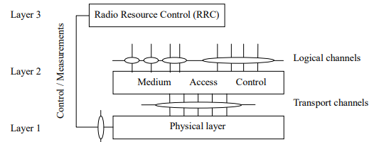
Radio interface protocol architecture around the physical layer
The above figure shows the NR radio interface protocol architecture around the physical layer (Layer 1). The physical layer interfaces the Medium Access Control (MAC) sub-layer of Layer 2 and the Radio Resource Control (RRC) Layer of Layer 3. The circles between different layer/sub-layers indicate Service Access Points (SAPs). The physical layer offers a transport channel to MAC. The transport channel is characterized by how the information is transferred over the radio interface. MAC offers different logical channels to the Radio Link Control (RLC) sub-layer of Layer 2. A logical channel is characterized by the type of information transferred.

Slide 28
Physical channels and modulation
The physical channels defined in the
Downlink are:
Uplink are
PDSCH
PDCCH
PBCH
PRACH
PUSCH
PUCCH

Slide 29
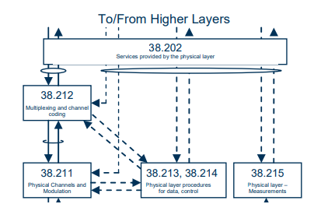
Relation between Physical Layer specifications
38.202: Physical layer services provided by the physical layer
Services and functions of the physical layer;
Model of physical layer of the UE;
Parallel transmission of simultaneous physical channels and SRS;
Measurements provided by the physical layer.
38.211: Physical channels and modulation
The scope is to establish the characteristics of the Layer-1 physical channels, generation of physical layer signals and modulation, and to specify:
Definition of the uplink, downlink and sidelink physical channels;
Frame structure and physical resources;
Modulation mapping (BPSK, QPSK, etc);
OFDM signal generation;
Scrambling, modulation and upconversion;
Layer mapping and precoding;
Physical shared channel in uplink, downlink and sidelink;
Reference signal in uplink, downlink and sidelink;

Slide 30
38.212: Multiplexing and channel coding
The scope is to describe the transport channel and control channel data processing, including multiplexing, channel coding and interleaving, and to specify:
Channel coding schemes;
Rate matching;
Uplink transport channels and control information;
Downlink transport channels and control information;
Sidelink transport channels and control information.
38.213: Physical layer procedures for control
The scope is to establish the characteristics of the physical layer procedures for control, and to specify:
Synchronization procedures;
Uplink power control;
Random access procedure;
UE procedure for reporting control information;
UE procedure for receiving control information.
38.215: Physical layer
Measurements
The scope is to establish the characteristics of the physical layer measurements, and to specify:
Control of UE/NG-RAN measurements;
Measurement capabilities for NR.
38.214: Physical layer procedures for data
The scope is to establish the characteristics of the physical layer procedures for data, and to specify:
Power control;
Physical downlink shared channel related procedures;
Physical uplink shared channel related procedure;
Physical sidelink shared channel related procedure.

Slide 31
Overview of L1 functions
The physical layer is expected to perform the following functions to provide the data transport service:
Error detection on the transport channel and indication to higher layers;
FEC encoding/decoding of the transport channel;
Hybrid ARQ soft-combining;
Rate matching of the coded transport channel to physical channels;
Mapping of the coded transport channel onto physical channels;
Power weighting of physical channels;
Modulation and demodulation of physical channels;
Frequency and time synchronisation;
Radio characteristics measurements and indication to higher layers;
Multiple Input Multiple Output (MIMO) antenna processing;
RF processing.

Slide 32
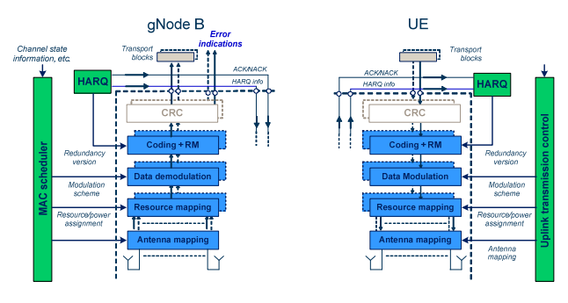
Physical-layer model for UL-SCH transmission
Uplink shared channel
The physical-layer model for Uplink Shared Channel transmission is described based on the corresponding PUSCH physical-layer-processing chain, see Figure Processing steps that are relevant for the physical-layer model, e.g. in the sense that they are configurable by higher layers, are highlighted in blue.
Higher-layer data passed to/from the physical layer
CRC and transport-block-error indication
FEC and rate matching
Data modulation
Mapping to physical resource
Multi-antenna processing
Support of L1 control and Hybrid-ARQ-related signalling

Slide 33
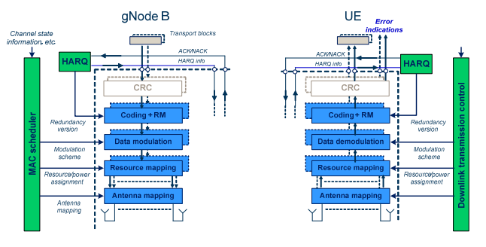
Physical-layer model for DL-SCH transmission
Downlink shared channel
The physical-layer model for Downlink Shared Channel transmission is described based on the corresponding PDSCH physical-layer-processing chain, see Figure Processing steps that are relevant for the physical-layer model, e.g. in the sense that they are configurable by higher layers, are highlighted in blue.
Higher-layer data passed to/from the physical layer;
CRC and transport-block-error indication;
FEC and rate matching;
Data modulation;
Mapping to physical resource;
Multi-antenna processing;
Support of L1 control and Hybrid-ARQ-related signalling

Slide 34
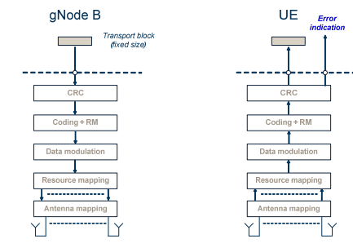
Physical-layer model for BCH transmission
Broadcast channel
The physical-layer model for BCH transmission is characterized by a fixed pre-defined transport format. There is one transport block for the BCH every 80ms. The BCH physical-layer model is described based on the corresponding PBCH physical-layer-processing chain, see Figure
Higher-layer data passed to/from the physical layer;
CRC and transport-block-error indication;
FEC and rate matching;
Data modulation;
Mapping to physical resource; -
Multi-antenna processing.

Slide 35

Uplink "Transmission Types"
Note 1
RACH corresponds to contention based.
Note 2
UCI on PUSCH without UL-SCH is possible
Note 3
For SCell, MsgA PRACH and MsgA PUSCH is not supported.

Slide 36
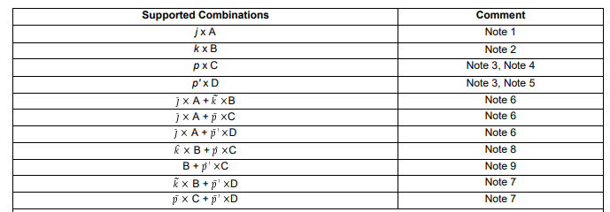
Uplink "Transmission Type" combinations
Note 1
The number of cell groups j in the supported combination is subject to UE capability
Note 2
The number of PUCCH groups k in the supported combination is subject to UE capability
Note 3
The number of carriers p, and p' in the supported combinations are subject to UE capability
Note 4
In the case there is one SUL carrier, then p-1 would be supported
Note 5
UE may be configured with p' but may also have capability to simultaneously sound less than this number
Note 6
Simultaneous PRACH with PUCCH (or PUSCH or SRS) is supported only in the case of inter-band CA j~<=j,k~<=k,p~<=p
Note 7
Simultaneous SRS with PUCCH (or PUSCH) is supported only in the case of inter-band CA k~<=k,p~<=p
Note 8
Simultaneous PUCCH and PUSCH(s) for the case that multiple PUCCH groups are configured and the respective PUCCH and PUSCH(s) are transmitted in the different PUCCH groups, with k~<k,p~<p are subject to UE capability for supported number of PUCCH groups and UL carriers, respectively. and ̂ depend on configuration
Note 9
Simultaneous PUCCH and PUSCH(s) within the same PUCCH group in the case of inter-band CA, p depending on the configuration, and subject to UE capability for parallel transmission of PUCCH and PUSCH within the same PUCCH group.

Slide 37
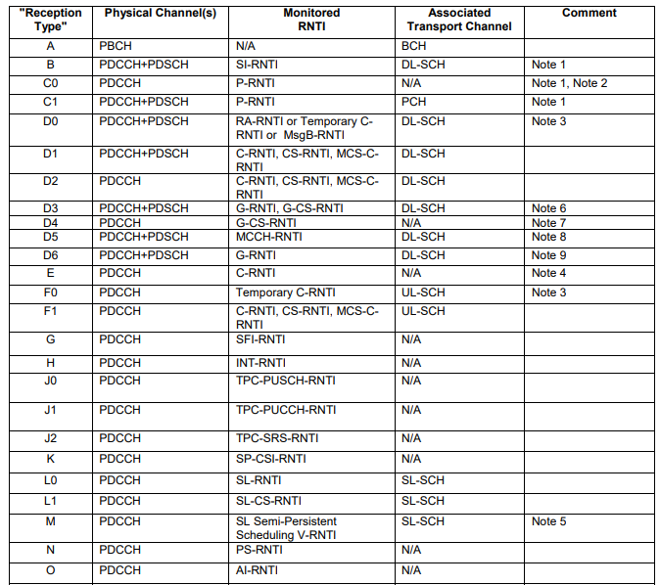
Downlink "Reception Types"
Note 1
These are received from PCell only
Note 2
In some cases UE is only required to monitor the
short message within the DCI for P-RNTI.
Note 3
These are received from PCell or PSCell.
Note 4
This corresponds to PDCCH-ordered PRACH
Note 5
This corresponds to PDCCH scheduling LTE PC5
Note 6
This is for multicast in RRC connected state
Note 7
This corresponds to DL Semi-Persistent Scheduling release for multicast in RRC connected state
Note 8
This is for broadcast MCCH
Note 9
This is for broadcast MTCH. UE is not required to decode more than one PDSCH for MTCH simultaneously

Slide 38
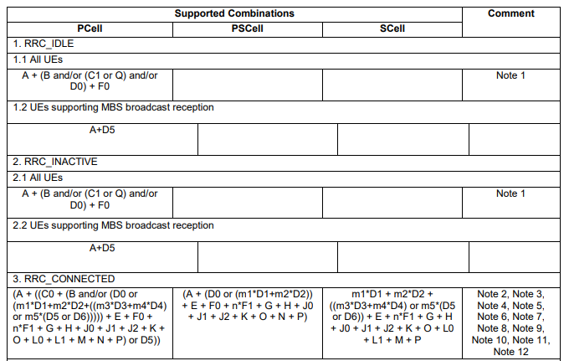
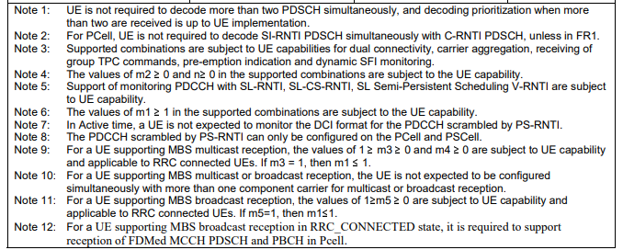
Downlink "Reception Type" combinations

Slide 39
PUSCH (PHYSICAL UPLINK SHARED CHANNEL)
Scrambling
Modulation
Layer mapping
Transform precoding
Precoding
Mapping to virtual resource blocks
Mapping from virtual to physical resource blocks

Slide 40
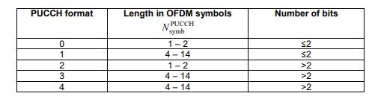
PUCCH (PHYSICAL UPLINK CONTROL CHANNEL)
The physical uplink control channel supports multiple formats
Mapping to physical resources
Sequence and cyclic shift hopping
PUCCH format 0
PUCCH format 1
PUCCH format 2
Group and sequence hopping
Cyclic shift hopping
Sequence generation
Mapping to physical resources
Sequence modulation
Mapping to physical resources
Scrambling
Modulation
Spreading

Slide 41
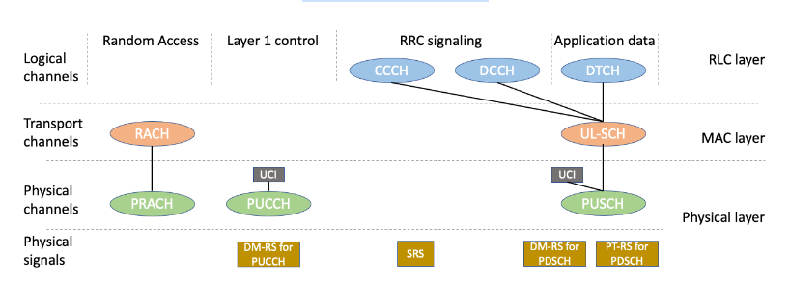
Uplink channel mapping
Common Control Channel (CCCH) and Dedicated Control Channel (DCCH) are used to transfer RRC signaling messages, i.e. data belonging to the set of Signaling Radio Bearers (SRB).
Dedicated Traffic Channel (DTCH) is used to transfer application data.
CCCH, DCCCH, DTCH all map to UL-SCH and PUSCH.
Physical Uplink Control Channel (PUCCH) transfers Uplink Control Information (UCI), including Scheduling Requests, HARQ Acknowledgements and Channel State Information (CSI). It is not used to transfer higher layer information.
Random Access Channel (RACH) is used to transfer the index of the preamble sequence.
Demodulation Reference Signals (DM-RS) are sequences which are known to the base station. They are needed for base station to estimate the channel properties for PUCCH and PUSCH.
Sounding Reference Signal (SRS) is used by the base station for channel aware packet scheduling and link adaptation.
Phase Tracking Reference Signal (PT-RS) is used to compensate for phase noise generated by the local oscillators at both the transmitter and receiver.

Slide 42
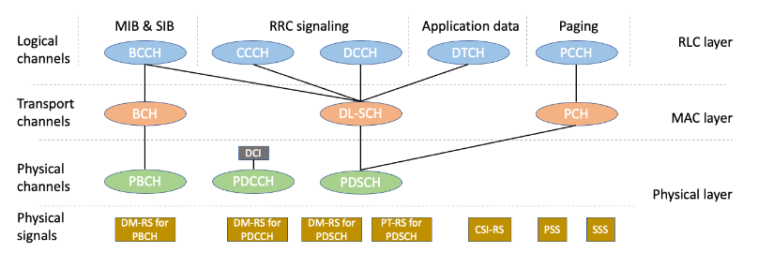
Downlink channel mapping
Broadcast Control Channel (BCCH) is used to transfer both the Master Information Block (MIB) and System Information Blocks (SIB). MIB is mapped to BCH and PBCH; SIBs are mapped to DL-SCH and PDSCH.
Common Control Channel (CCCH) and Dedicated Control Channel (DCCH) are used to transfer RRC signaling messages.
Dedicated Traffic Channel (DTCH) is used to transfer application data.
CCCH, DCCCH, DTCH all map to DL-SCH and PDSCH.
Physical Downlink Control Channel (PDCCH) transfers Downlink Control Information (DCI), which is used by the base station to allocate uplink and downlink resources. DCI can also be used to provide uplink power control commands, config slot format, and indicate that pre-emption has occurred. It is not used to transfer higher layer information.
Demodulation Reference Signals (DM-RS) are sequences which are known to the UE. They are needed for UE to estimate the channel properties for PBCH, PDCCH, and PDSCH.
Phase Tracking Reference Signal (PT-RS) is used to compensate for phase noise generated by the local oscillators at both the transmitter and receiver.
Channel State Information Reference Signal (CSI-RS) is used by the UE to measure and report channel quality. This information can be used by the link adaptation algorithm at the Base Station. It can also be used for beam management and connected mode mobility procedures.
Primary Synchronization Signal (PSS) and Secondary Synchronization Signal (SSS) are used during the cell search procedure and beam management procedure. SSS is used for Reference Signal Received Power (RSRP) and Reference Signal Received Quality (RSRQ) measurements.

Slide 43
END
Thank You

